Slide 1
Travel Express
A project on itinerary booking
TEJASHREE PANDIT
ANANT SHRI PANTHRI
KHYATI MISHRA

Slide 2
Project Outline
Travel Express is a dynamic web application that enables user to book tickets, hotels and decide his travel itinerary.
Web pages are developed using java web servlets, JSP and JavaScript.
The application is making use of relational database implemented on Oracle SQL Developer.

Slide 3
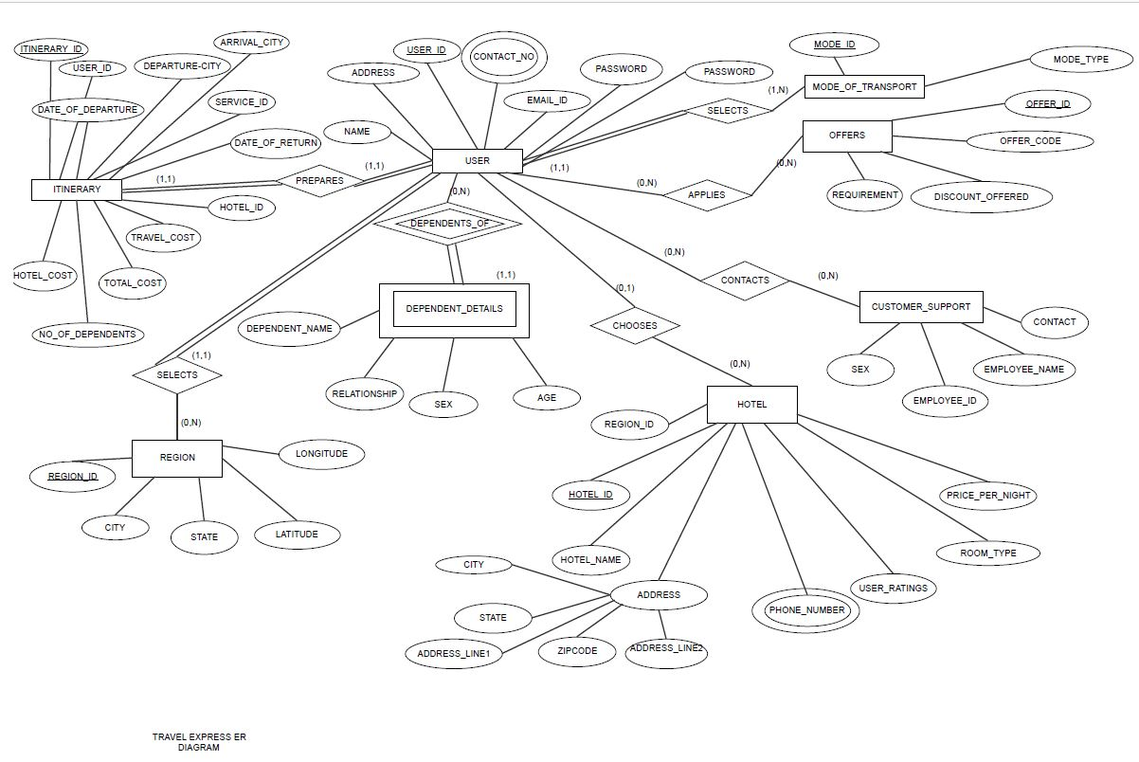
Database highlights
Database comprises of 8 major entities
Dependent_details is in a identifying relationship with user.
Contact_No attribute of user is multi valued.
Address attribute of hotel is composite.

Slide 4
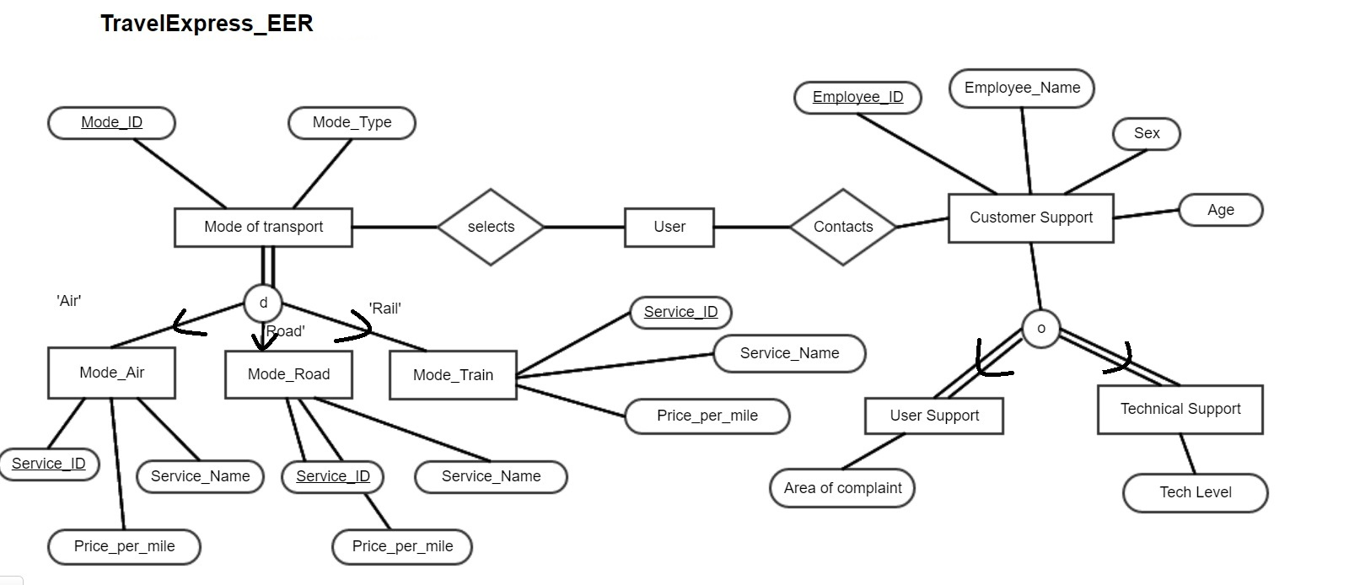
Database highlights (contd..)
Mode_of_Transport is a superclass entity having Mode_Air, Mode_Road and Mode_Train as subclass entities.
Customer Support is a superclass entity having User Support and Technical Support as subclass entities.

Slide 5
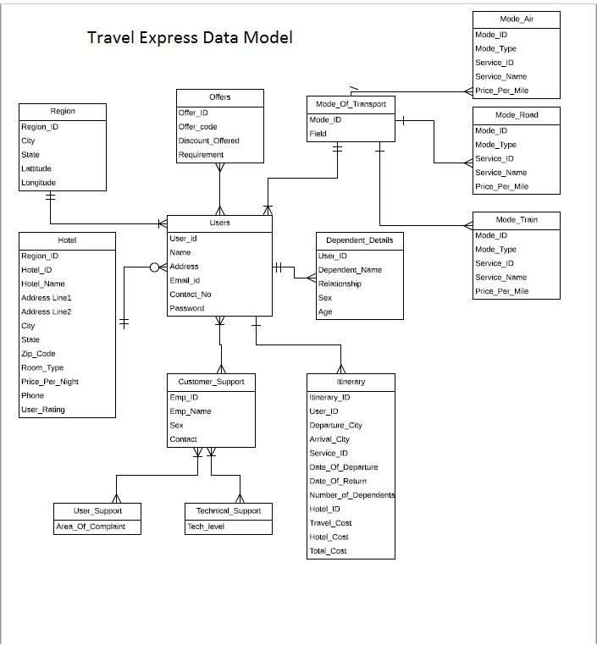
Data Model

Slide 6
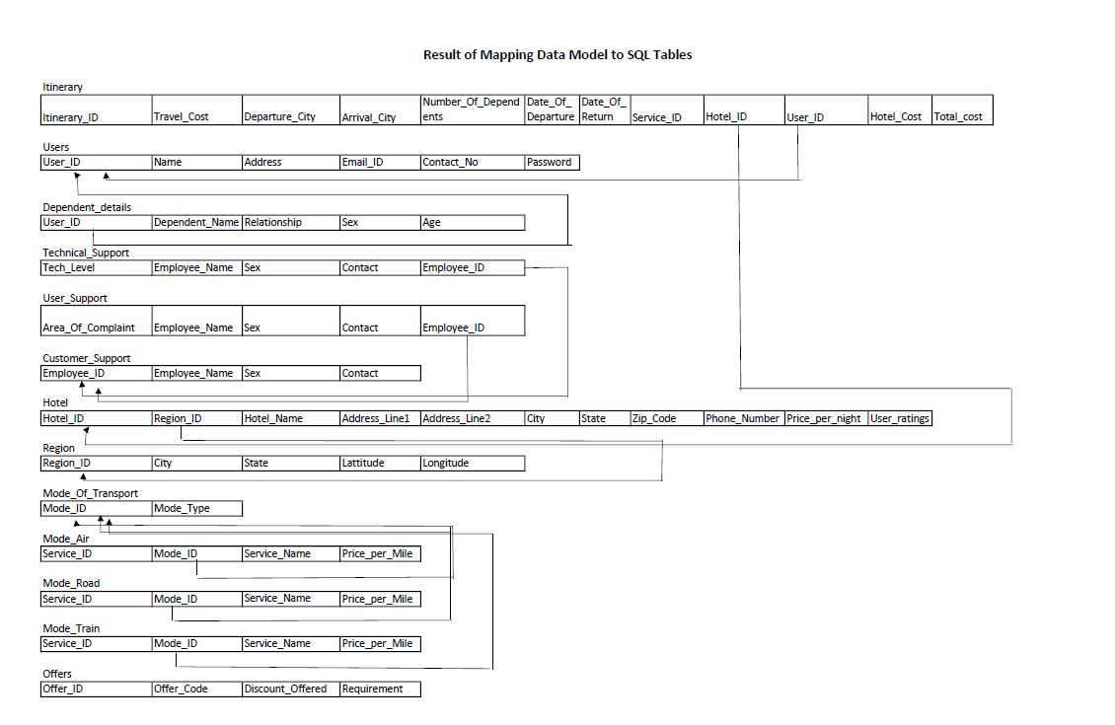
Mapping of Data Model to SQL
This is the mapping of our data model to relational schema.
It gives us an idea of how the tables are related to each other.

Slide 7

So are you ready to travel?
Source: http://www.whitebird.org/wp-content/uploads/Travel-womanArmsOutstretched-147079253.jpg

Slide 8
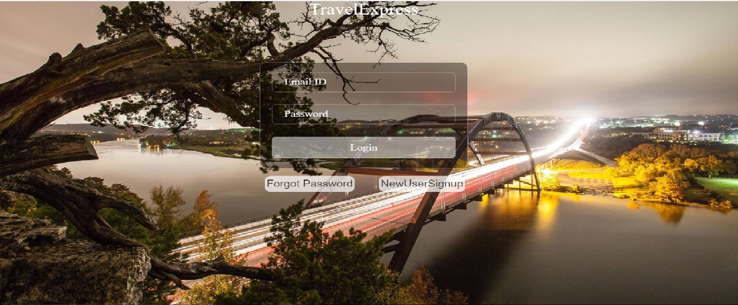
Login to Travel Express
Here you can login into our application.
We are making use of simple queries like insert to enter new user details into the database.
For registered users, we retrieve the data from Database by validating username and password.

Slide 9
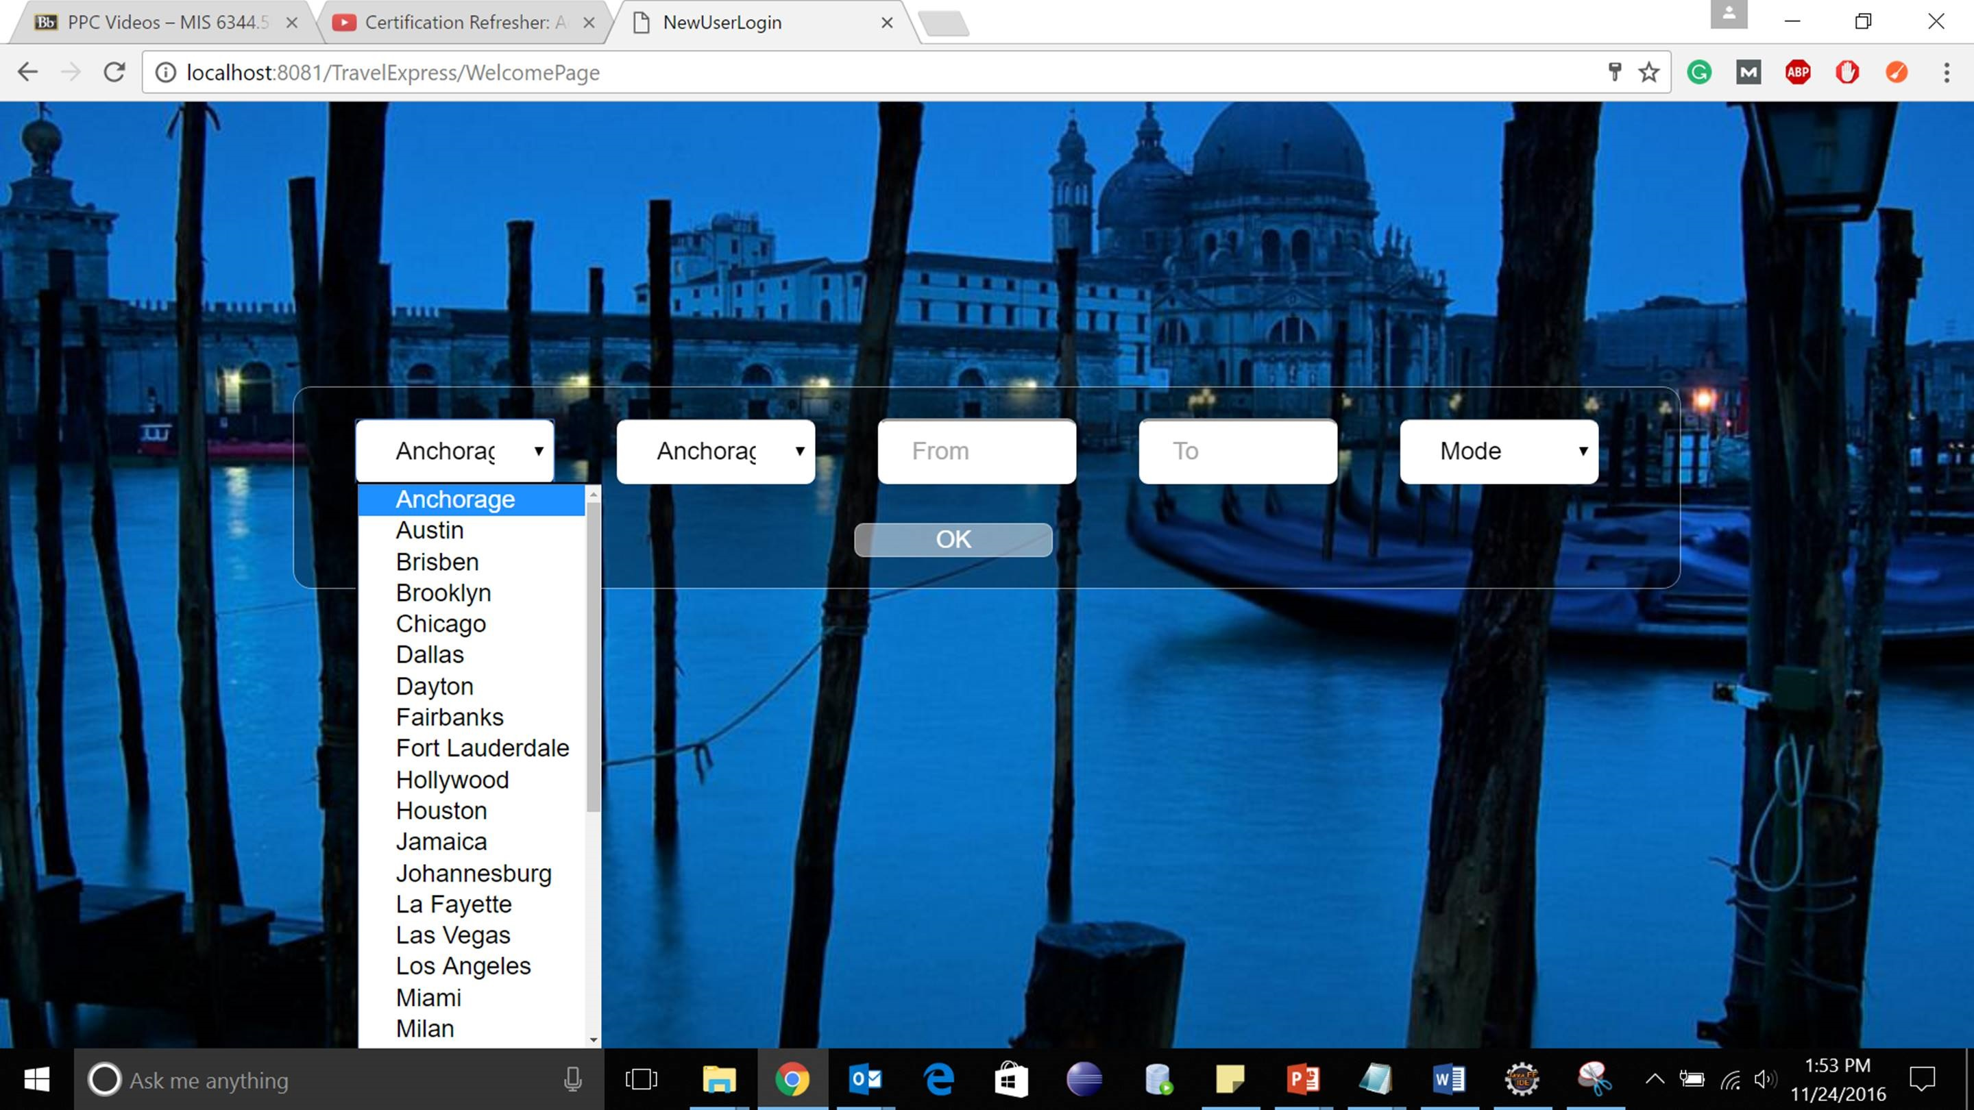
Select your dream destination!
Here you can select your ‘from’ and ‘to’ cities.
The data is populated from region table in the dropdown using select query.

Slide 10
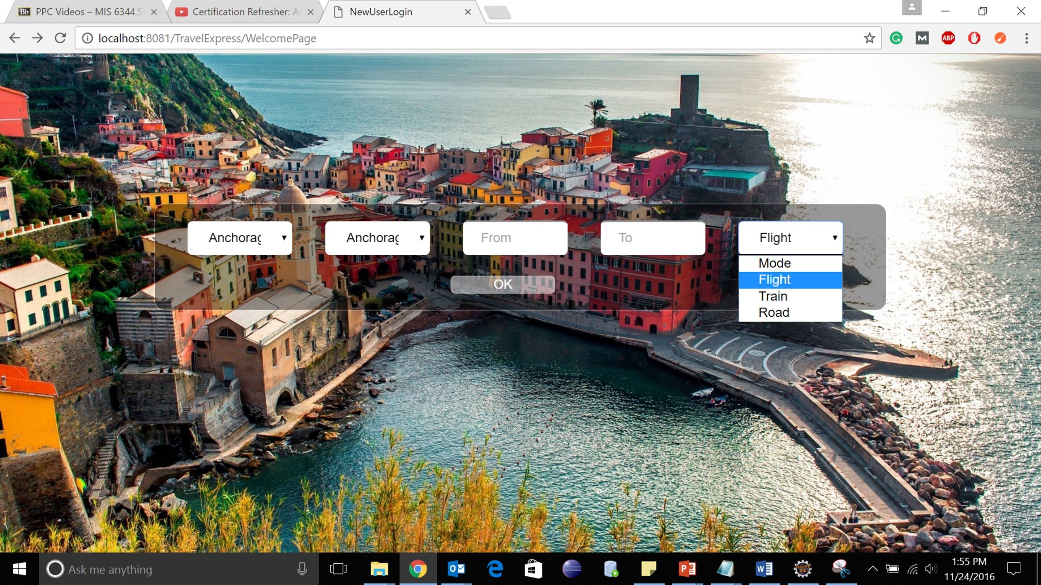
Tell us how would you like to travel?
The user is given the facility to select different modes of transport- flight, train and road.
Here the data is fetched from tables – region and mode_of_transport using simple queries.

Slide 11
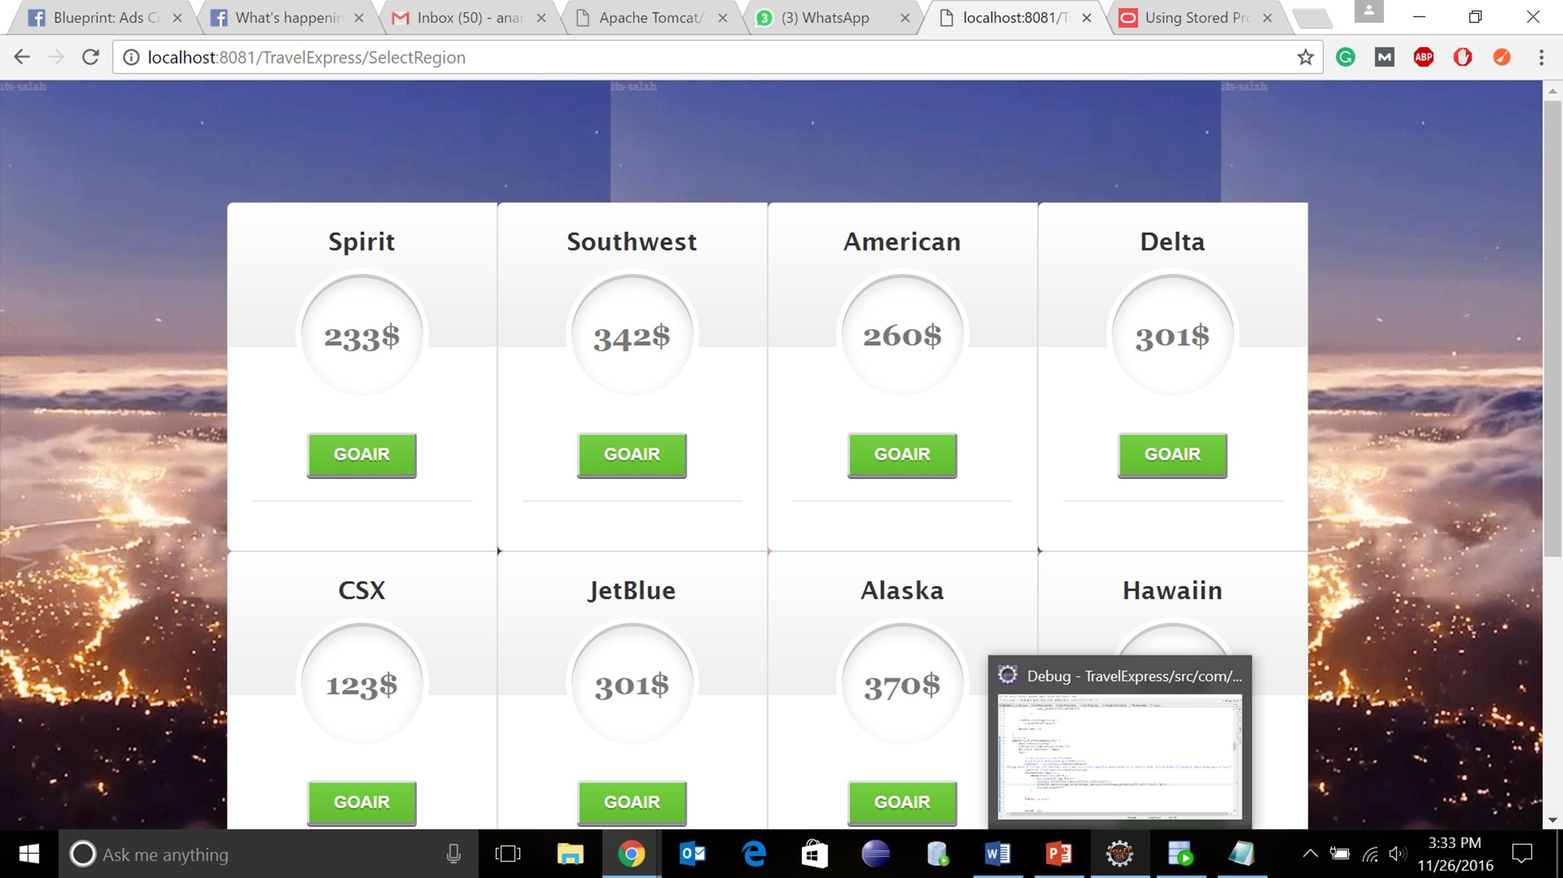
Select competitive rates
Provision is given to compare rates of different services. Select one that suits your needs.
The function distance() calculates the distance between any two cities selected by user.
Rate_Calculation procedure is used to calculate the rate of different airlines using distance calculated from the above function.

Slide 12
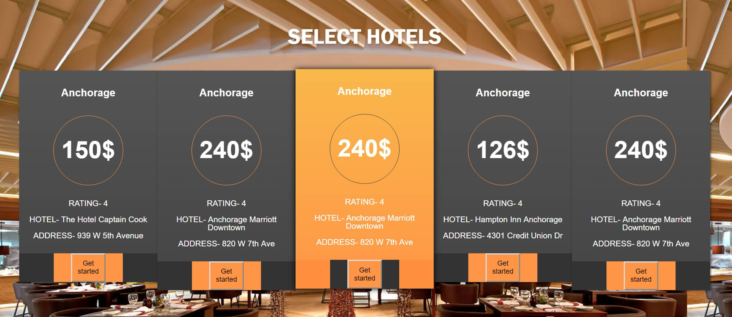
Where would you like to stay?
Hotel rates are selected from the table ‘Hotel’ using select statement.
After selecting the hotel, the total itinerary cost of user is calculated by using join query between ‘itinerary’ and ‘hotel’ tables.

Slide 13
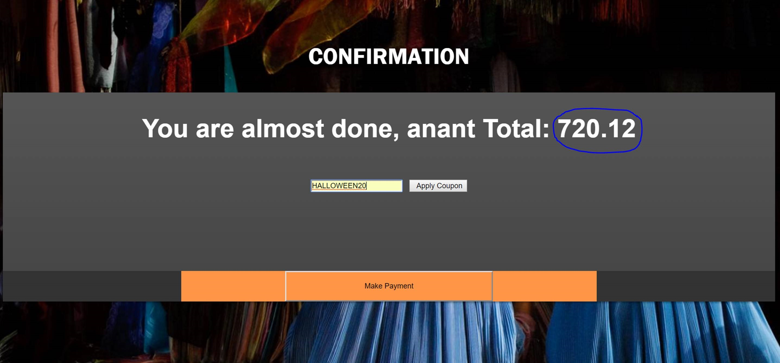
Are you ready to roll?
User can apply promo codes to discount the total cost of itinerary.
Depending on the promo code selected, the discount formula is applied on the amount using SQL query.

Slide 14
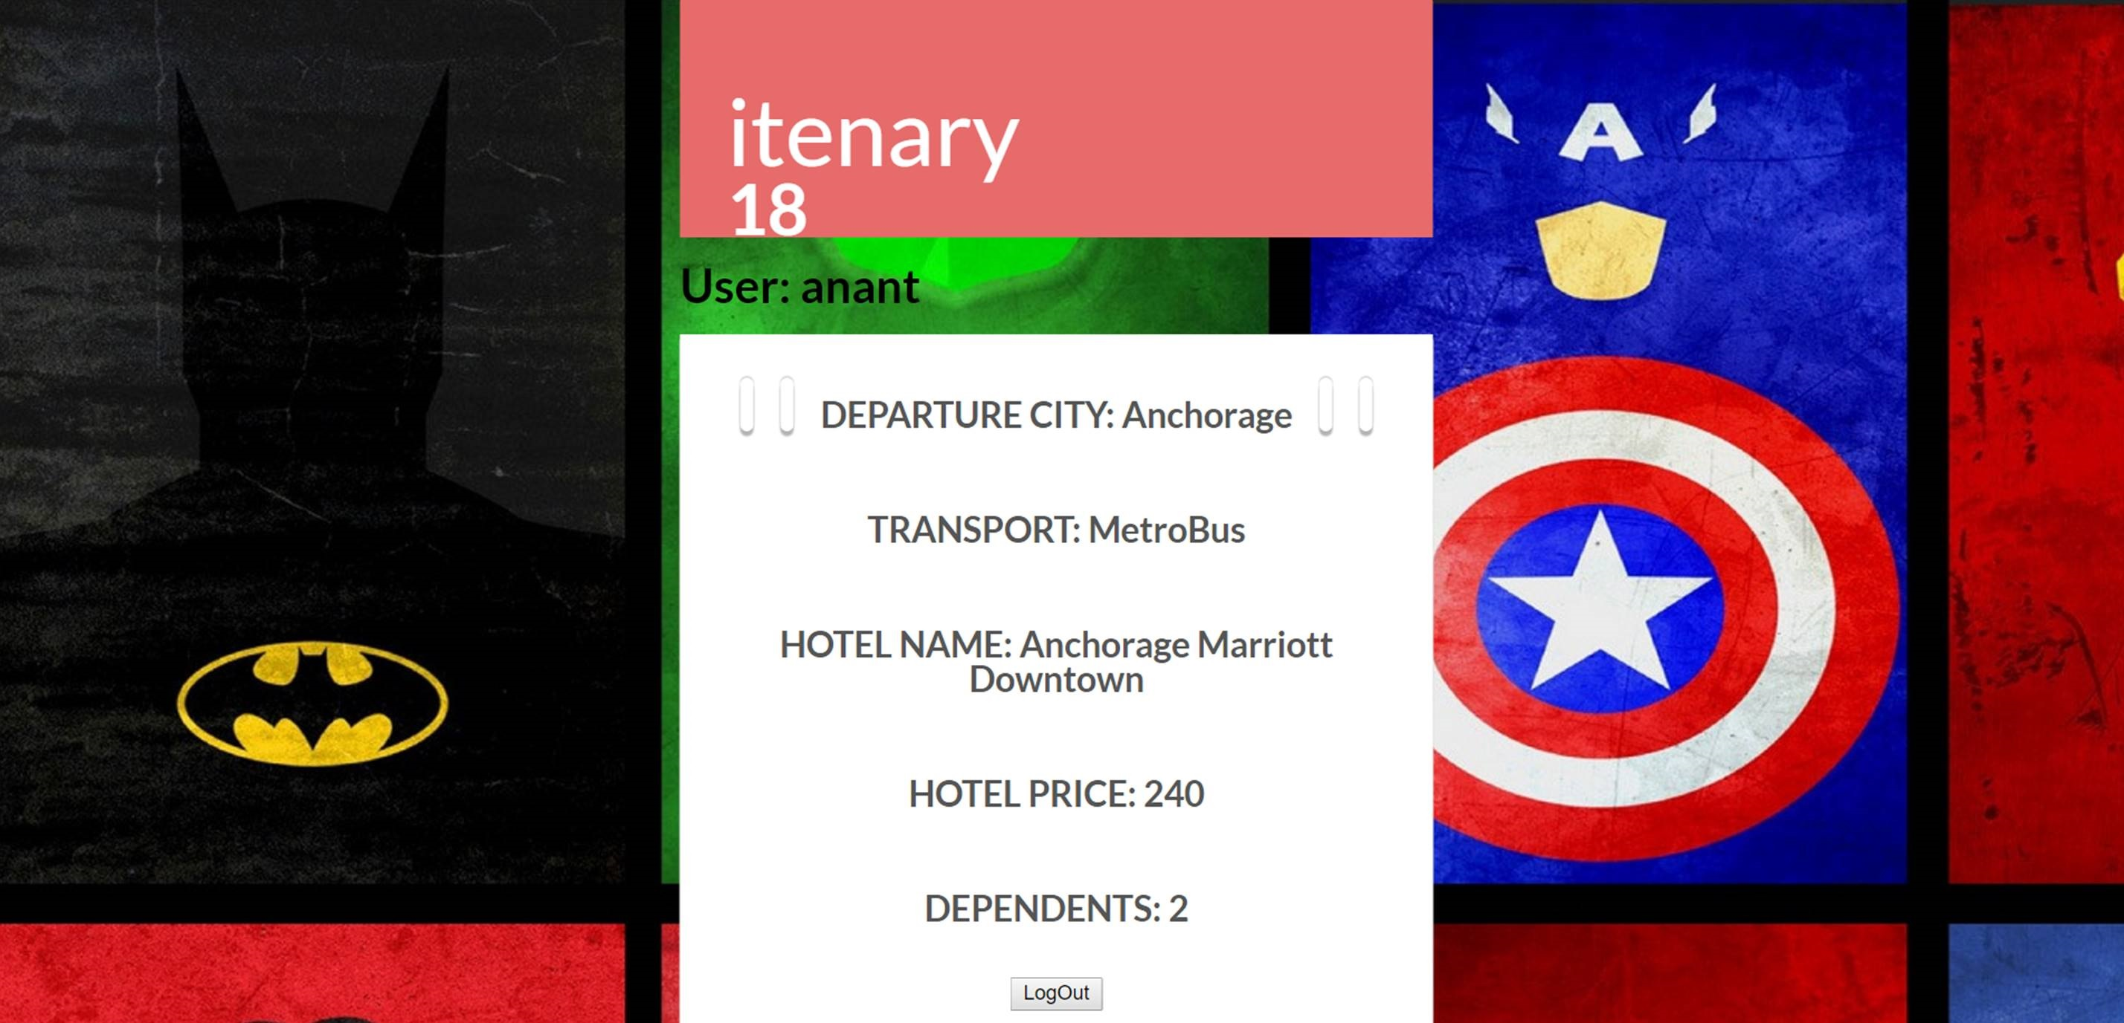
Here goes your Itinerary!
We are displaying the final itinerary details information on this web page.
The data is fetched from the itinerary table using select statement.

Slide 15
Thank you

